Slide 1
Biodiversity in US National Parks

Slide 2
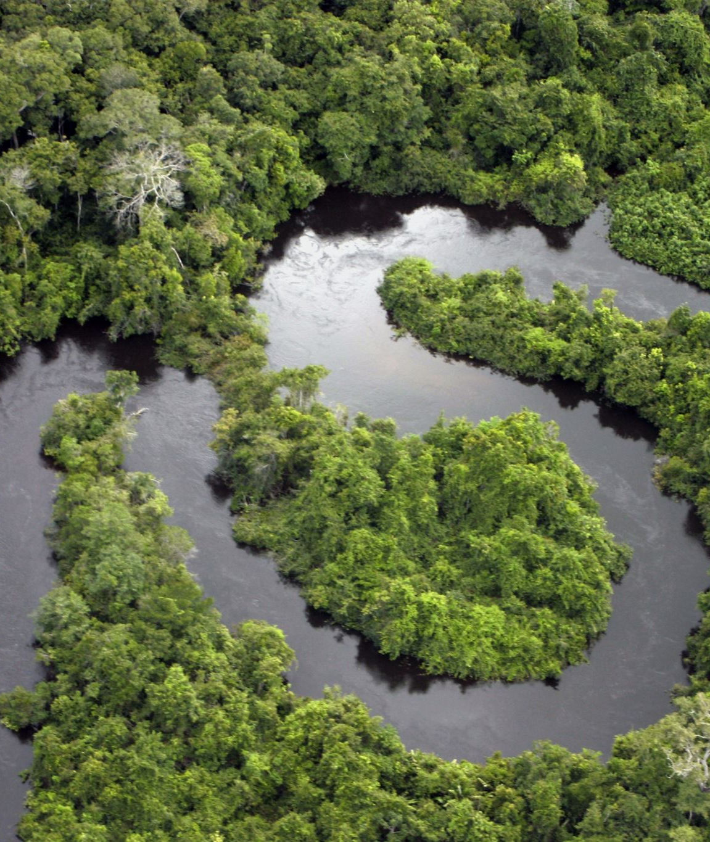
Goal
The goal of this project to is analyze biodiversity data in US National Parks to better understand the distribution of the conservation status of species in these parks.

Slide 3
The project sought to answer the following questions:
What is the distribution of conservation status for species?
Are certain types of species more likely to be endangered?
Are the differences between species and their conservation status significant?
Which species are In Recovery and what is the overall distributions in the parks compared to the average observations of the species with other conservation statuses?

Slide 4
Data Sources
species_info.csv
observations.csv
Note: The data for this project is inspired by real data but is mostly fictional. The data was provided by Codecademy.

Slide 5
species_info.csv
This is the file that contains information pertaining to the various species in the National Parks.
It has four columns:
category: The category of taxonomy for each species
scientific_name: The scientific name of the species
common_names: The common name(s) of the species
conservation_status: The conservation status of the species ('Species of Concern' 'Endangered' 'Threatened' 'In Recovery'). If null, then the species is not in danger
The file consists of 5824 rows and 4 columns.

Slide 6
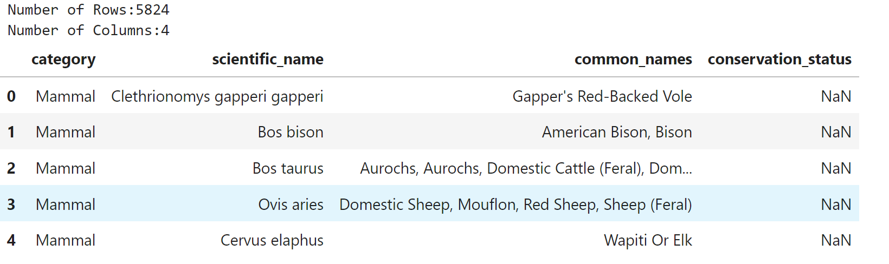
species_info.csv

Slide 7
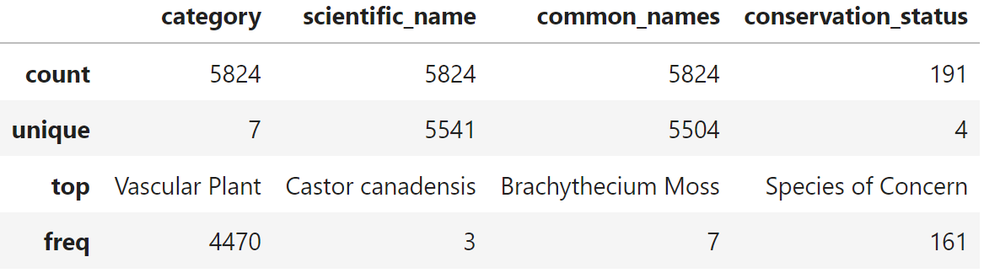
species_info.csv

Slide 8
species_info.csv

Slide 9
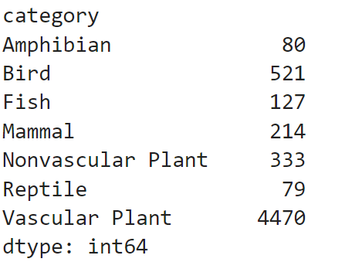
species_info.csv
The category column has the following 7 unique values:
Mammal
Bird
Reptile
Amphibian
Fish
Vascular Plant
Nonvascular Plant

Slide 10
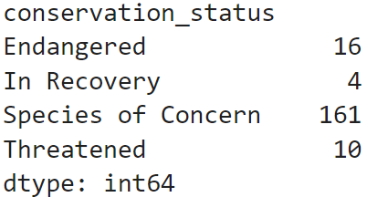
species_info.csv
The conservation_status column has the following 4 unique values:
Species of Concern: declining or appear to be in need of conservation
Endangered: seriously at risk of extinction
Threatened: vulnerable to endangerment in the near future
In Recovery: formerly Endangered, but in recovery of endangerment
There are 5633 records that have a null value in conservation_status. These signify that the species is not a protected species.

Slide 11
species_info.csv

Slide 12
species_info.csv
There are 283 duplicates in the scientific name.

Slide 13
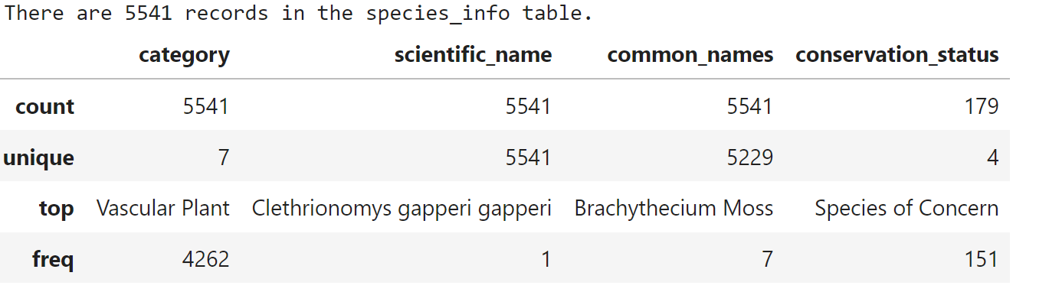
species_info.csv
After dropping the duplicates, this is the new summary information of species_info.csv

Slide 14
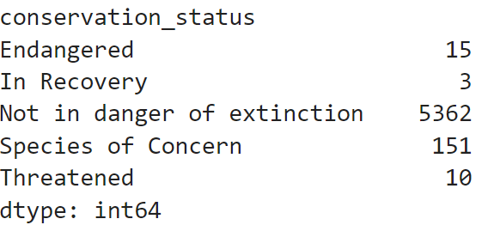
species_info.csv
We replaced the null values in the conservation_status column (i.e. the species that are not protected) with “Not in danger of extinction”.
Note: Since the duplicates were removed, the numbers are a little different from the original.

Slide 15
observations.csv
This is the file that contains information from recorded sightings of different species throughout the national parks in the past 7 days.
It has three columns:
scientific_name: The scientific name of the species
park_name: The name of the National Park
observations: The number of observations in the past 7 days
The file consists of 23296 rows and 3 columns.

Slide 16
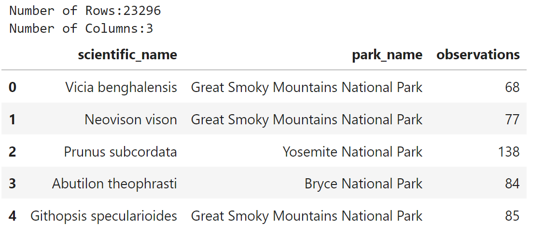
observations.csv

Slide 17
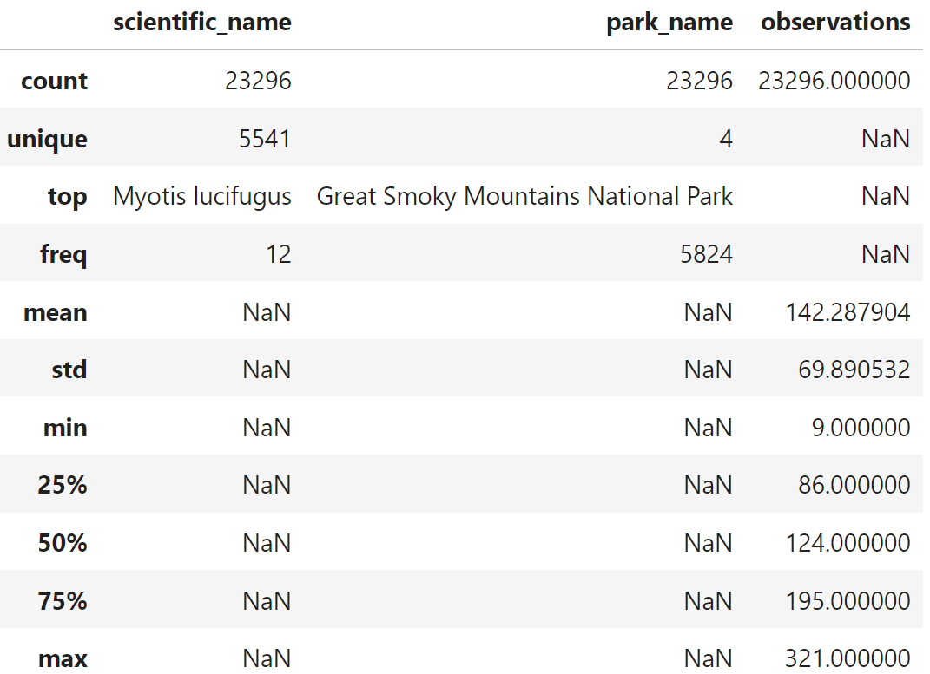
observations.csv

Slide 18
observations.csv

Slide 19
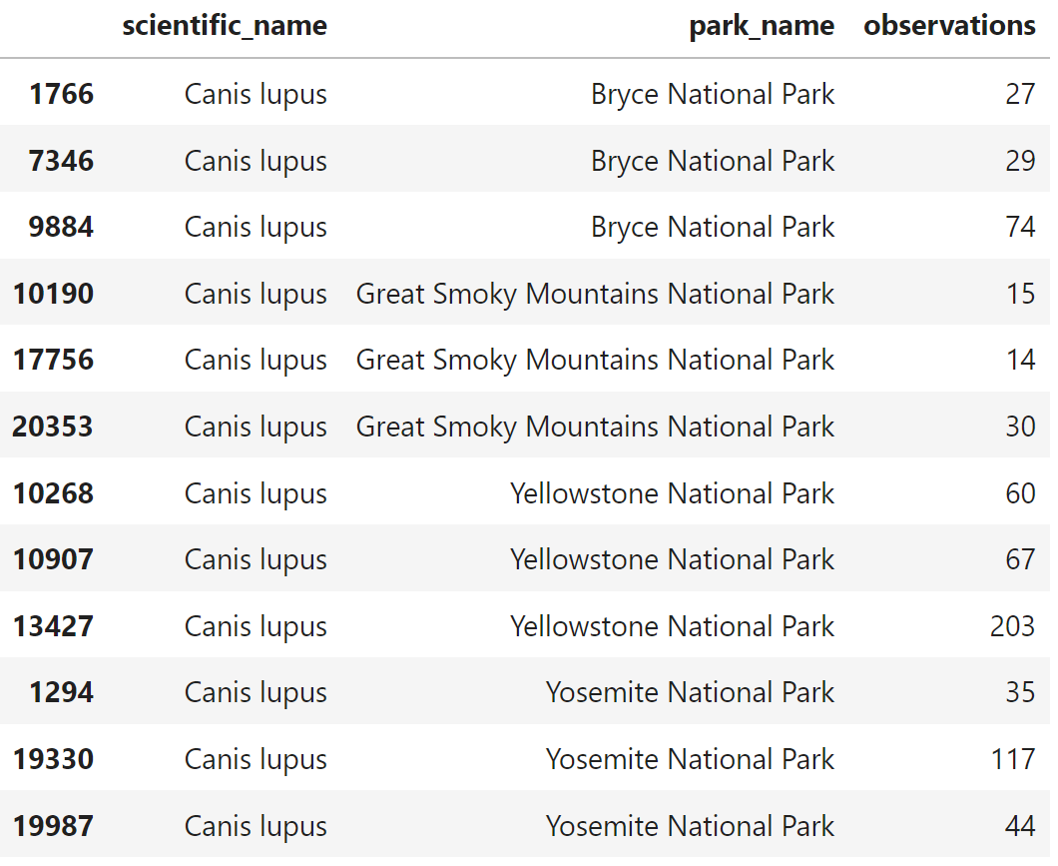
observations.csv
There were duplicate rows with different observations.
We summarized the observations into a single row.

Slide 20
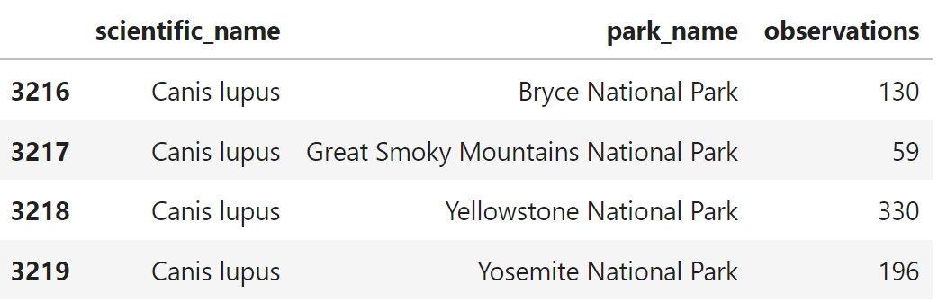
observations.csv
This resulted in 22164 rows and 3 columns.

Slide 21

The Analysis

Slide 22
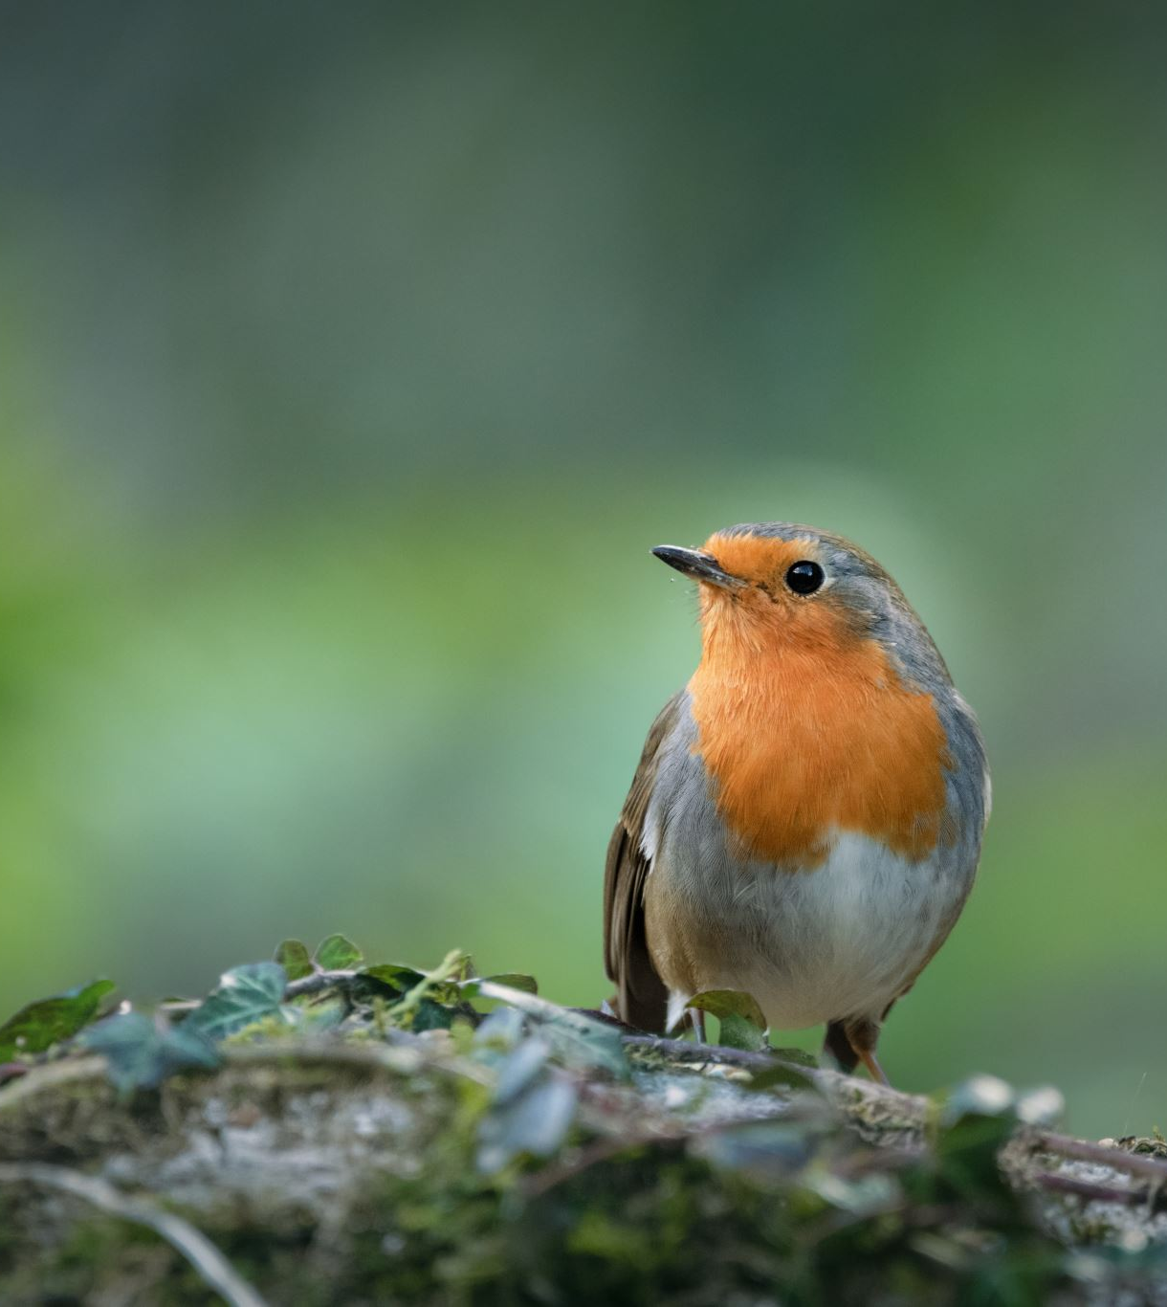
What is the distribution of conservation status for species?
We found that 5362 species are not in the conservation program while 179 species are protected species.

Slide 23
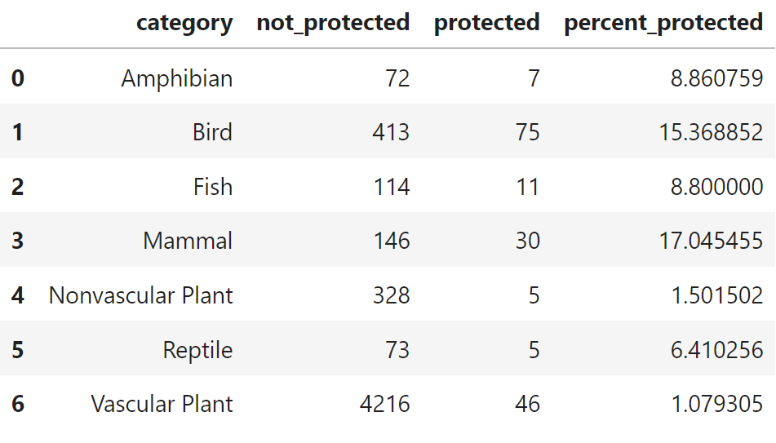
Are certain types of species more likely to be endangered?
We found that Mammal and Bird categories had the highest percentage of protected species.

Slide 24
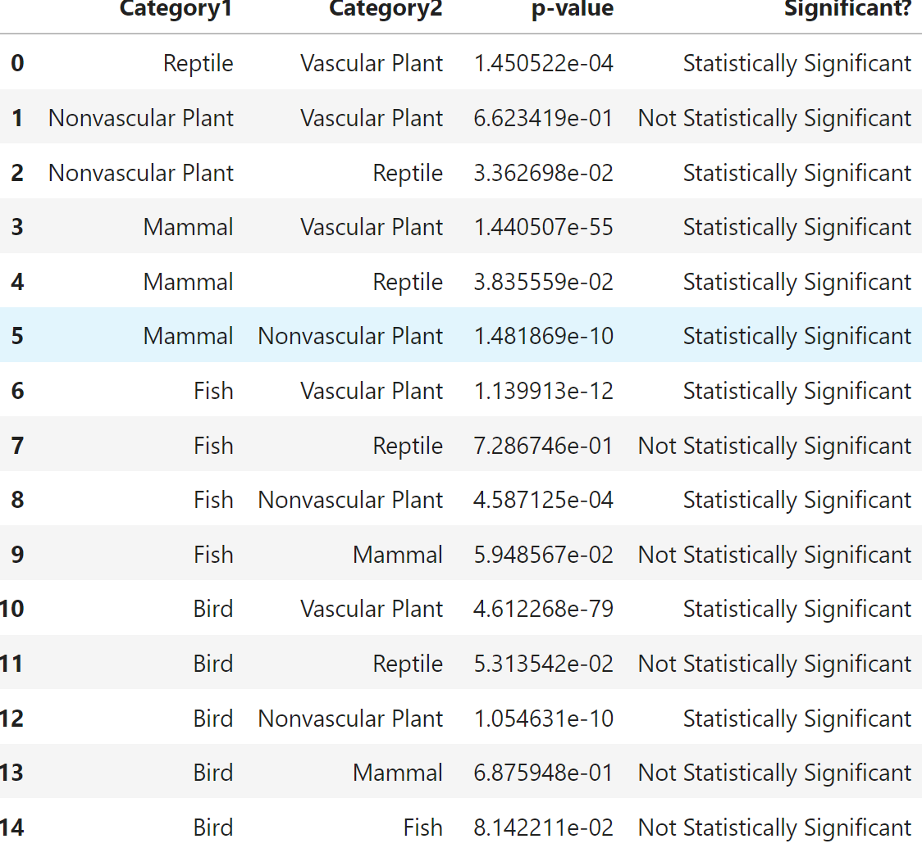
Are the differences between species and their conservation status significant?
As seen in the table, some differences in species and their conservation status are significant and some are not.

Slide 25
Are the differences between species and their conservation status significant?
As seen in the table, some differences in species and their conservation status are significant and some are not.
Eg: Mammals and Birds are not statistically significant while Mammals and Reptiles are statistically significant

Slide 26
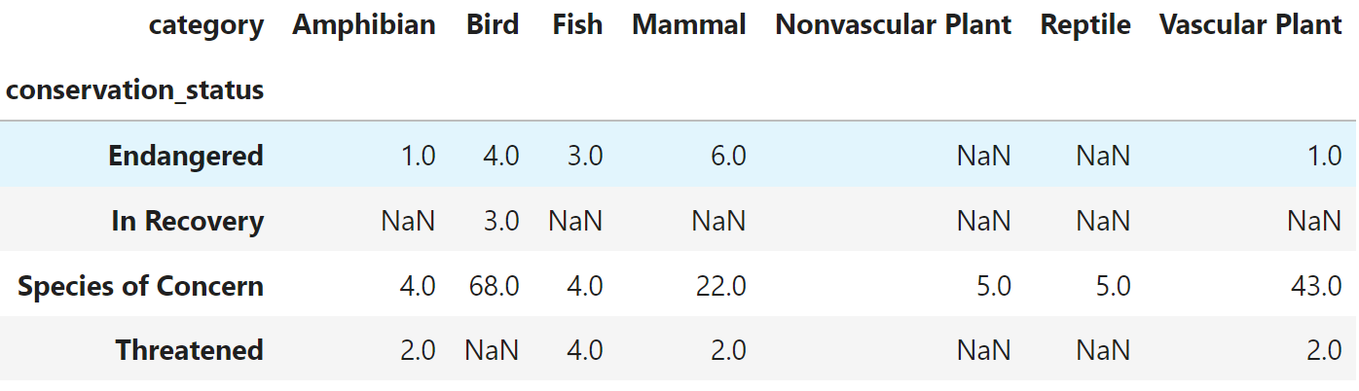
Which species are In Recovery and what is the overall distributions in the parks compared to the average observations of the species with other conservation statuses?

Slide 27
Which species are In Recovery and what is the overall distributions in the parks compared to the average observations of the species with other conservation statuses?

Slide 28
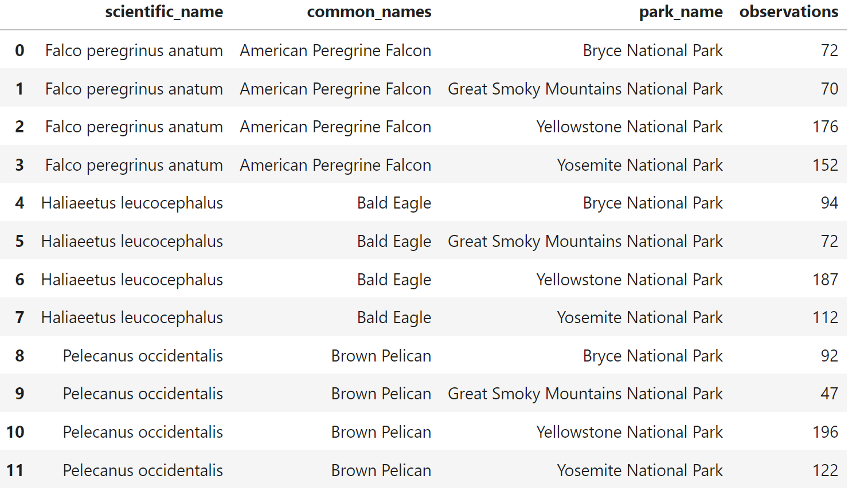
Which species are In Recovery and what is the overall distributions in the parks compared to the average observations of the species with other conservation statuses?
The three species In Recovery:
Falco peregrinus anatum (American Peregrine Falcon)
Haliaeetus leucocephalus (Bald Eagle)
Pelecanus occidentalis (Brown Pelican)

Slide 29
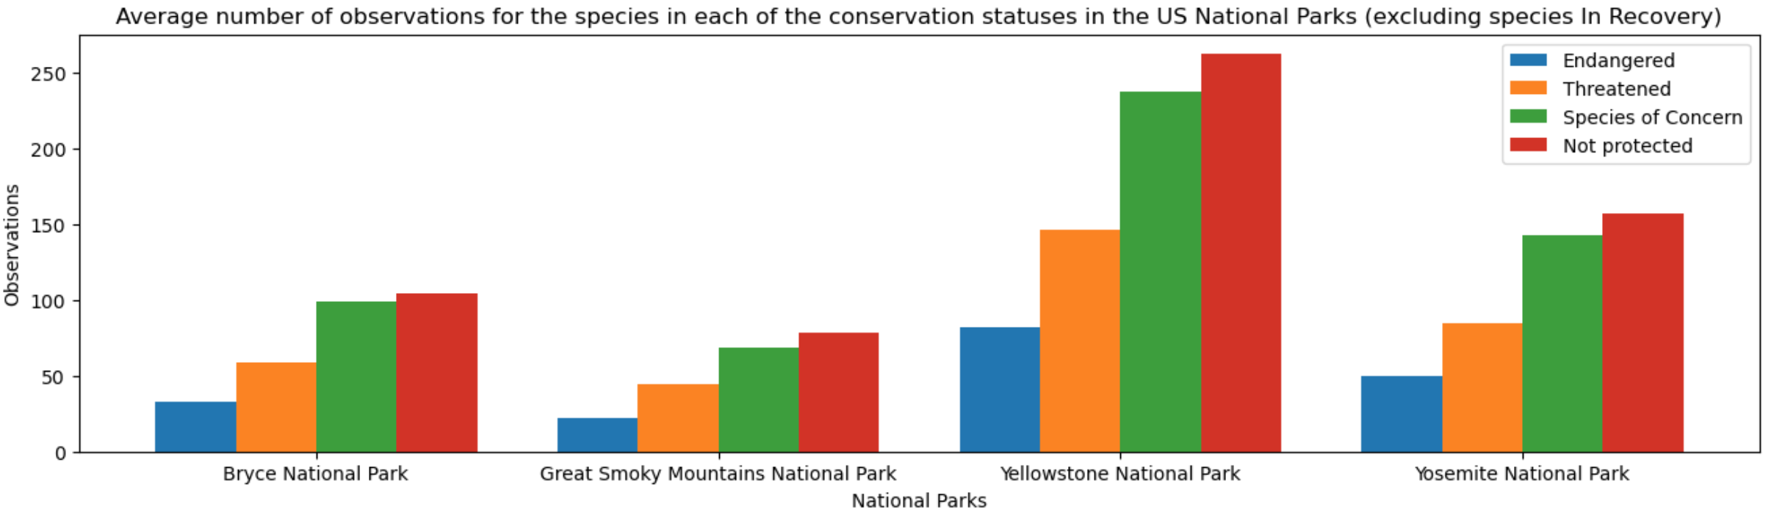
Which species are In Recovery and what is the overall distributions in the parks compared to the average observations of the species with other conservation statuses?

Slide 30
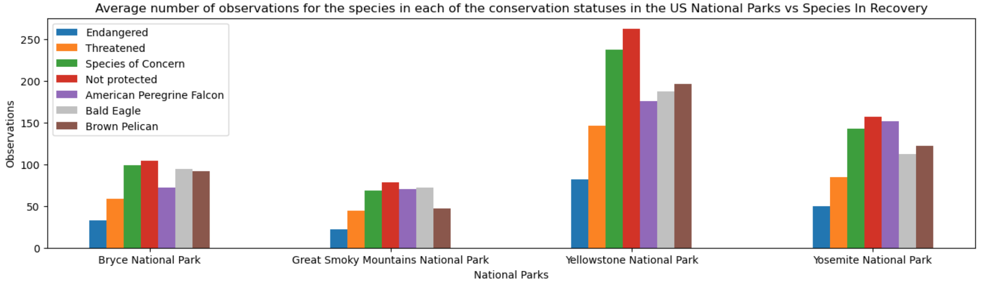
Which species are In Recovery and what is the overall distributions in the parks compared to the average observations of the species with other conservation statuses?

Slide 31
Which species are In Recovery and what is the overall distributions in the parks compared to the average observations of the species with other conservation statuses?
The observations for the In Recovery species fell mostly between the average value for Species of Concern and Threatened or close to the average value for Species of Concern which is what is expected. However, there were a few instances where that was not the case.

Slide 32
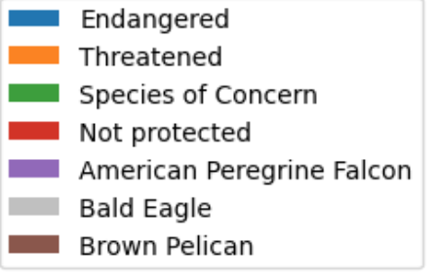
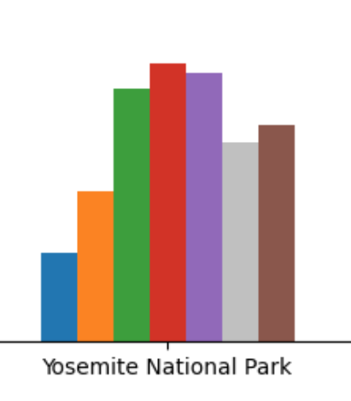
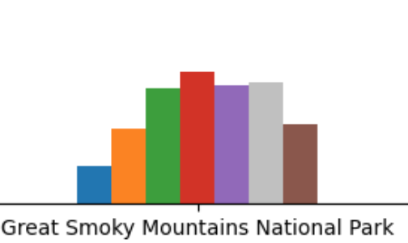
Which species are In Recovery and what is the overall distributions in the parks compared to the average observations of the species with other conservation statuses?
In Yosemite,
The American Peregrine Falcon had observations that were higher than the average observations for Species of Concern species but lower than the average observations for Not Protected species in the National Park.
The Bald Eagle and the Brown Pelican fall in between Threatened and Species of Concern.
In Great Smoky Mountains,
The observations for the American Peregrine Falcon were around the average observations of the Species of Concern.
The observations for the Bald Eagle were higher than the average observations for Species of Concern species but lower than the average observations for Not Protected species in the National Park.
The Brown Pelican observations fall in between Threatened and Species of Concern.

Slide 33
Further Analysis
This dataset only included observations from the last 7 days. It would be curious to see how the conservation status for various species changes over time.
Another piece that is missing is the Area of each park, it can be assumed that Yellowstone National Park might be much larger than the other parks which would mean that it would exhibit more observations and greater biodiversity.
Lastly, if precise locations were recorded, the spatial distribution of the species could also be observed and test if these observations are spatially clustered.

Slide 34
Thank you

Slide 35
Appendix
Duplicates in common names were observed in species_info.csv due to spellings and other common user errors. The common names were not a field that made a huge impact in our analysis, so the duplicates were ignored.

